Slide 1
Branch4
BART Analytics

Slide 2
To ride or not to ride Bart?
That is the question

Slide 3
Questions
What are the ridership yearly trends? What does the seasonality look like?
Hourly trends – when should I ride Bart if I don’t want a crowded train?
Was there an effect from a “Big Event” in 2016 to ridership?
Where people are exiting/boarding Bart the most?
Bart delays last ~2yrs
Weather affected?
Trends: When not to ride BART…

Slide 6
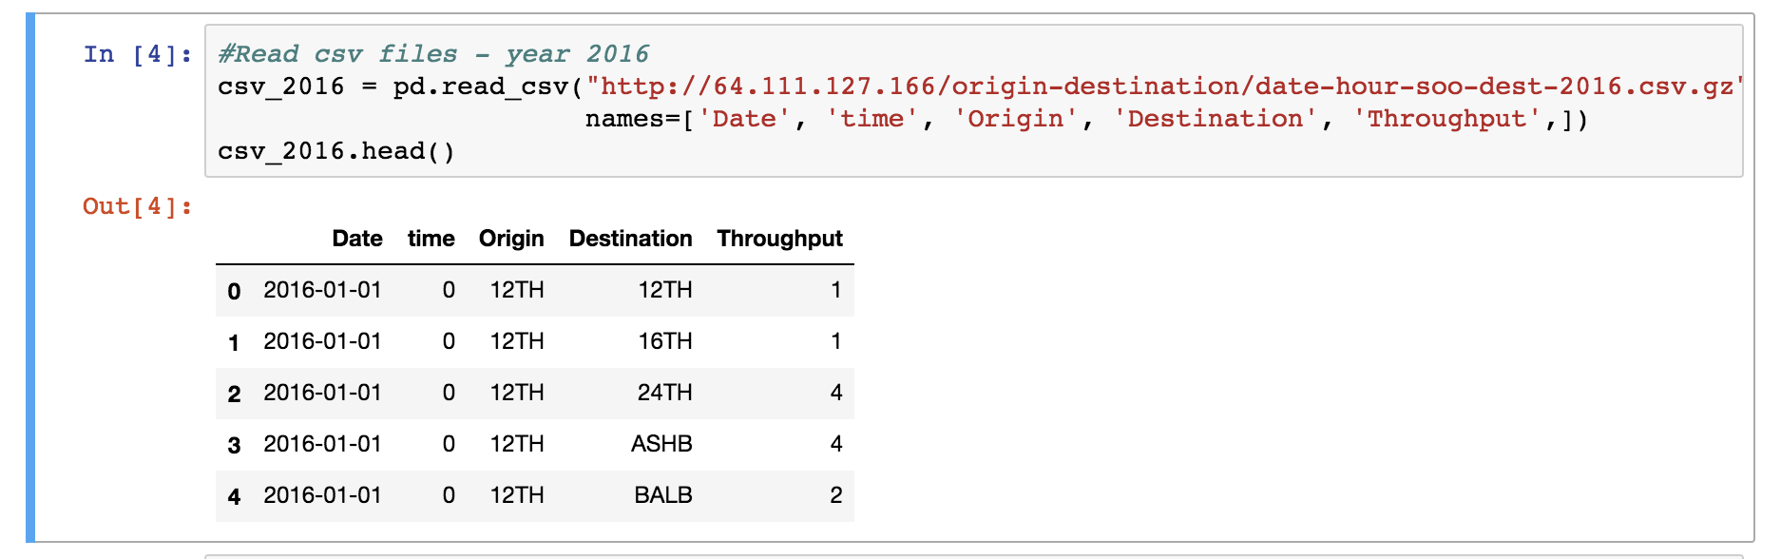
Code: Key Learnings
No need to download a large CSV file if a link to it is already available

Slide 7
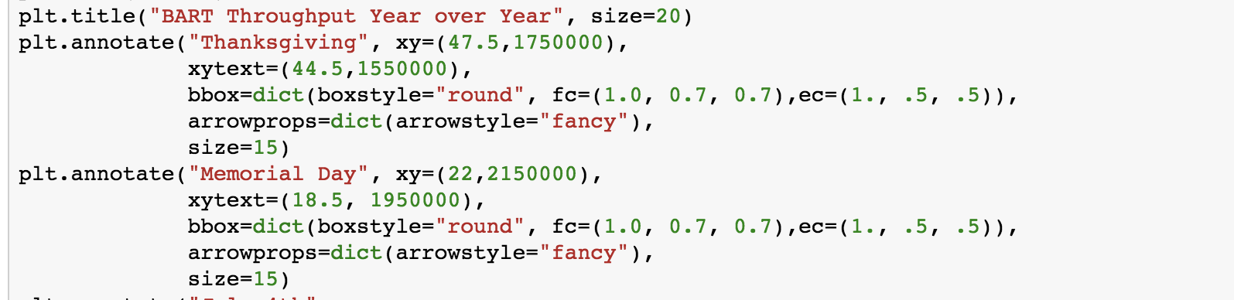
Code: Key Learnings
Annotate: Add notes directly to the chart

Slide 8
BART Delays
By: Lena

Slide 9
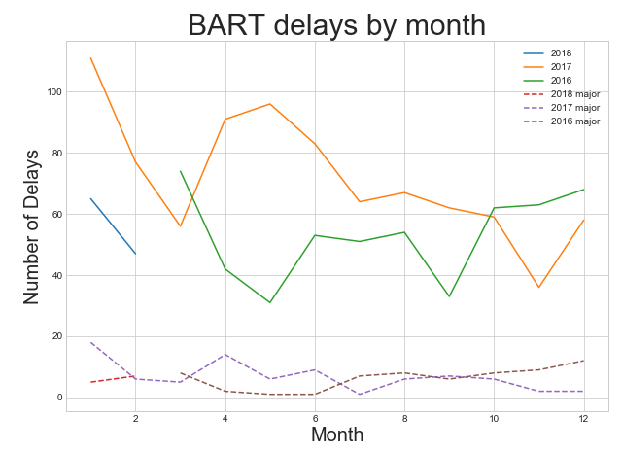
Question: Does BART have more delays during the winter?
2017 January rain days: 17
2018 January rain days: 11
Question: Are there good months to ride the BART?
Average delays: 67
Average major delays: 7
Year by year delays can be significantly different.
July to November are low delay months.

Slide 10
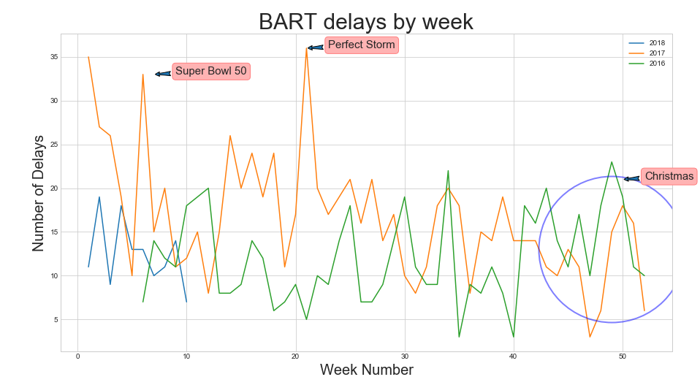

Slide 11
The Analysis
Core Message
Based on the data gathered, there is an average of 2 delays per day.
Data Source
BART API does not have delay data.
Overcoming Twitter API’s 7 days limit.
Weather underground for weather data.
Data Exploration and Cleanup/Assumptions
Text search: Filtered out tweets that says: BART Recovering
Only considered tweets that includes DELAY. Example: Station closed
Data Analysis
Used groupby to find the occurrence of delays and major delays.
More in depth analysis can be done.
Find the length of delay (10 mins). However, this may not be accurate or some tweets doesn’t even mention delays.
Find the stations affected by delay. The format of tweets are inconsistent.

Slide 12
The Analysis
Implication of Findings
BART does have its up and downs in terms of service interruptions. It is good for Lyft and Uber services.
It would be interesting to see how BART performs over 5 year period. Currently there’s no data source for long period.

Slide 13
Appendix

Slide 14
Resources used
Bart.gov ridership raw data: http://64.111.127.166/origin-destination/
Twitter API

Slide 15
Key terms
Throughput: Number of people that click in/out of a station

Slide 16
Split
Melody
Seasonality
Hourly trends – when should I ride Bart if I don’t want a crowded train
Mayur/Tony
What is the increase in ridership during the Superbowl 2016?
Heatmap by day
Where people are boarding the Bart the most?
Bubble plot by station/map
Where people are exiting the Bart the most?
Lena
Bart delays last ~2yrs
Weather affected?
Trends: When not to ride BART

